Slide 1


Smart Wheelchair using Arduino
Prepared by Jazan University students:
 | Student ID |  | Student Name
 | Student ID |  | Student Name
 |  |  | Supervisor
Computer and Network Engineering |  |  | Department
Computer Science & Information Technology |  |  | College

Slide 2
Abstract
For physically handicapped person we developed voice and gesture controlled wheelchair. The person who is handicapped or elderly can use this technology. This system is using voice and gesture. In voice system we use commands such as FORWARD, BACKWARD, LEFT, RIGHT, STOP. We recognized speech and getting a successful recognition rate 100% with this we are also using gesture controlling movement of wheelchair for this we use ultrasonic sensor. The ultrasonic sensor is directly connected to the microcontroller ARDUINO which is connected to the BLUETOOTH (HT 05 MODULE) this IC is connected to smart phone to transmits the data wirelessly. The motor gets the signal and then it will operate accordingly. The purpose of this system is to implement the direction control wheelchair with voice and gesture.
KEYWORDS: Microcontroller, Smart phone, Ultrasonic Sensor, Bluetooth Module.

Slide 3
Outline
Introduction
Objectives
Project Design
Test Cases
Gantt Chart
Acknowledgments

Slide 4

Introduction
Smart wheelchair is a type of assistive technology that allows individuals with physical disabilities to control the movement and operation of their wheelchair using their voice. These innovative devices are designed to provide greater independence and mobility for individuals who may not be able to operate a traditional manual wheelchair.
Smart wheelchairs use advanced technology such as voice recognition software and sensors to interpret and respond to voice commands.
One of the key benefits of a smart wheelchair is that it eliminates the need for physical controls or manual operation, which can be challenging for individuals with limited mobility in their hands or arms. This technology provides greater freedom and independence for users, allowing them to move around and navigate their environment with ease.

Slide 5

Introduction
Smart wheelchairs can be customized to meet the specific needs and preferences of individual users. The wheelchair is equipped with a voice recognition system that allows the user to control its movement, speed, and direction by speaking specific commands. The voice control system is designed to recognize a wide range of commands, including directional commands such as "go forward," "turn left," and "turn right," The system can also be programmed to recognize custom commands based on the user's specific needs and preferences.

Slide 6

Objectives
Ease of use: A smart wheelchair should be easy to use, even for people with limited mobility or dexterity.
Customization: A smart wheelchair should be customizable to meet the specific needs of the user. This may include adjusting the speed of the wheelchair, setting up custom voice commands
Safety: A smart wheelchair should be designed with safety in mind. It should include features such as obstacle detection and avoidance, and emergency stop buttons to prevent accidents and ensure the user's safety.
Enhanced Independence: Voice control enables wheelchair users to operate the wheelchair without relying solely on manual controls.

Slide 7

Hardware Requirements
1-Arduino UNO Board
Arduino simulator (Arduino IDE)
2-HC-05 Bluetooth Module
3-Motor Driver
4-Ultrasonic Sensor
5-I2C-LCD 1602 Module
5-Batteries
6-Two Tire Wheel with two-DC Motor
7-Movable Caster Wheel
8-Dupont Wire & Jumper Wire

Slide 8

Hardware Requirements& Project Design

Slide 9
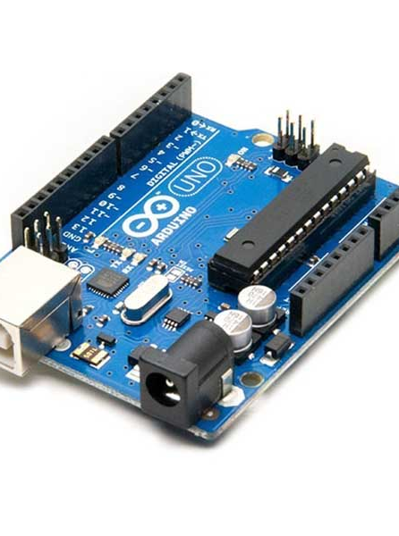
Hardware Requirements
1- Arduino UNO Board
Central Control Unit
Sensor Integration
Data Processing
Power

Slide 10
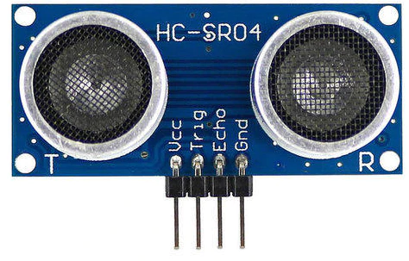
Hardware Requirements
2- Ultrasonic Sensor
Read the distance
Obstacle detection

Slide 11
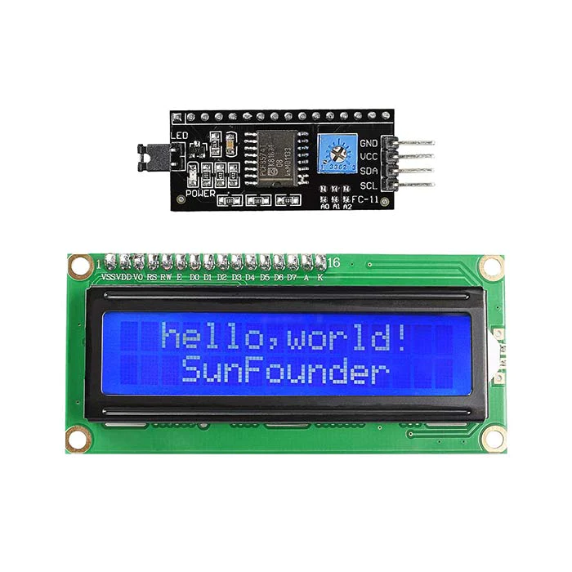
Hardware Requirements
3- I2C-LCD1602 Module
Print the distance on the screen
Print the input on the screen

Slide 12
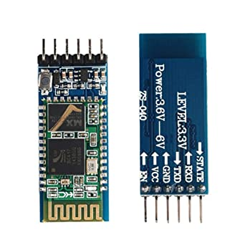
Hardware Requirements
4- HC-05 Bluetooth Module
To connect wireless with smart phone

Slide 13
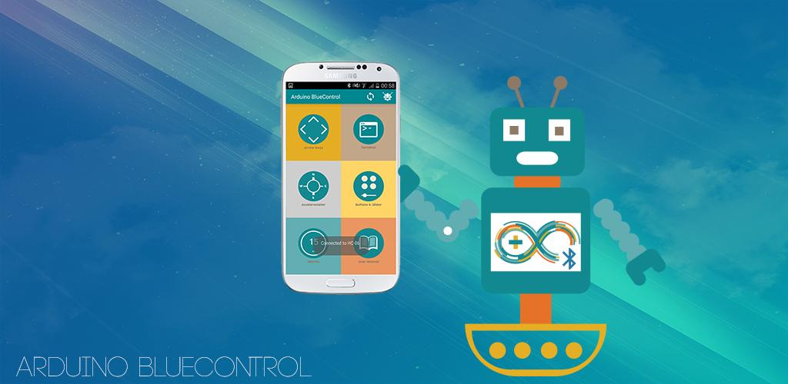
Hardware Requirements
5- Smart Phone
Download and install the application of “Arduino Blucontrol”
Connect to HC-05 Bluetooth
Control of smart wheelchair

Slide 14
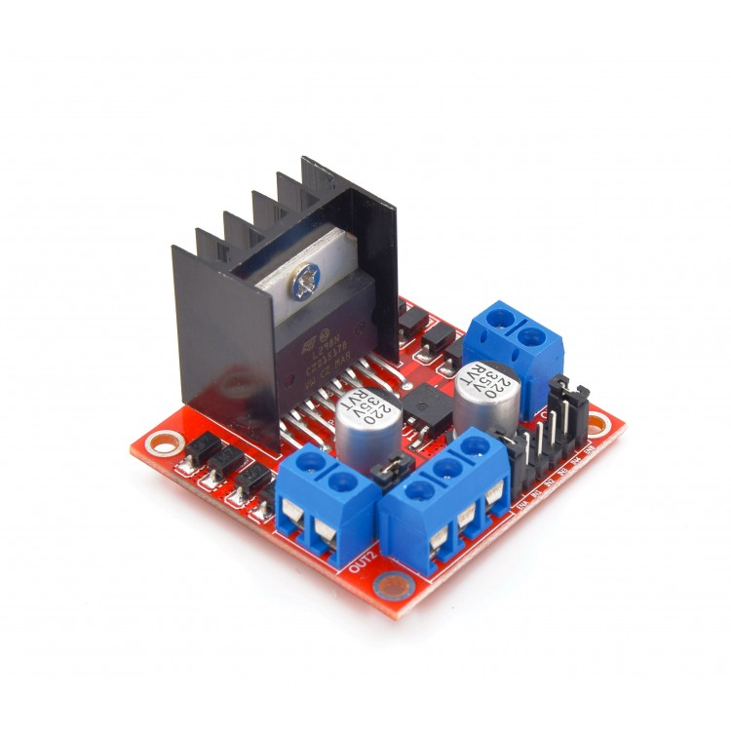
Hardware Requirements
6- Motor Driver
Controlling the movement of the wheelchair
Motor Control
Power Management

Slide 15

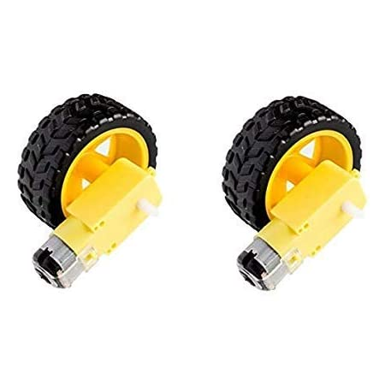
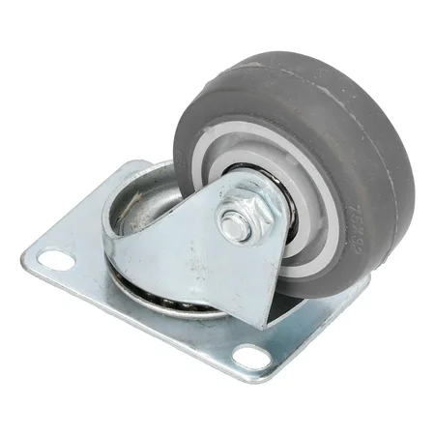
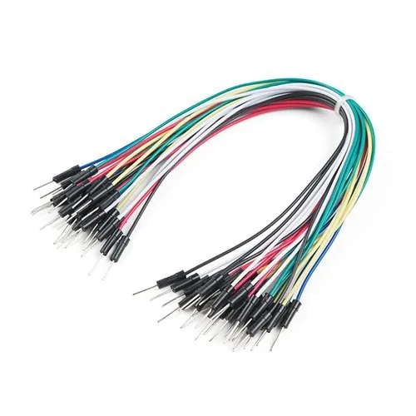
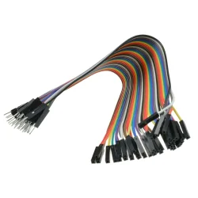
Hardware Requirements
Two Tire Wheel with two-DC Motor
Batteries
Movable Caster Wheel
Dupont Wire & Jumper Wire

Slide 16
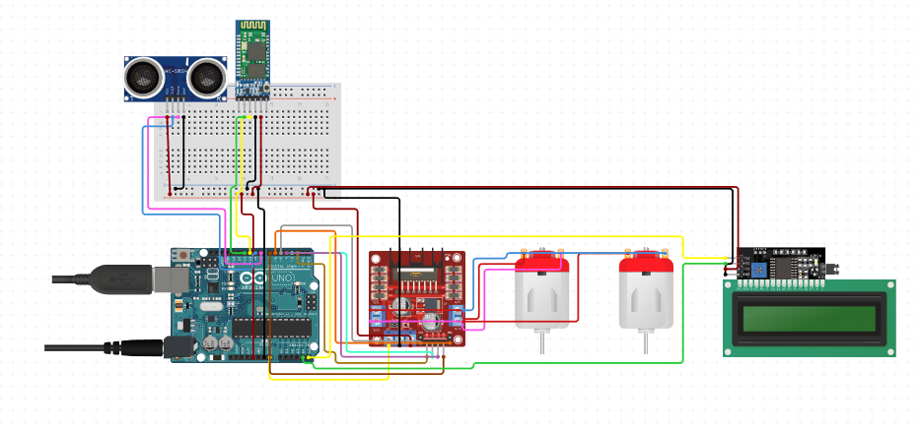
Circuit Diagram

Slide 17

Test Cases

Slide 18

Test Cases
In the testing phase, we tested the project in the experience of moving the chair forward, then to the right, then to the left, by voice commands, and it was in different places. The experiment was empowering and successful.
The input commands
Forward
Backward
Right
Left
Stop

Slide 19

Testing
Download and install "arduino bluecontrol" application on your smart phone and connect to "Smart Wheelchair’.
1-connect to (HC_05) Bluetooth to control the smart wheelchair
2-Choose voice control
3- Record voice inputs

Slide 20
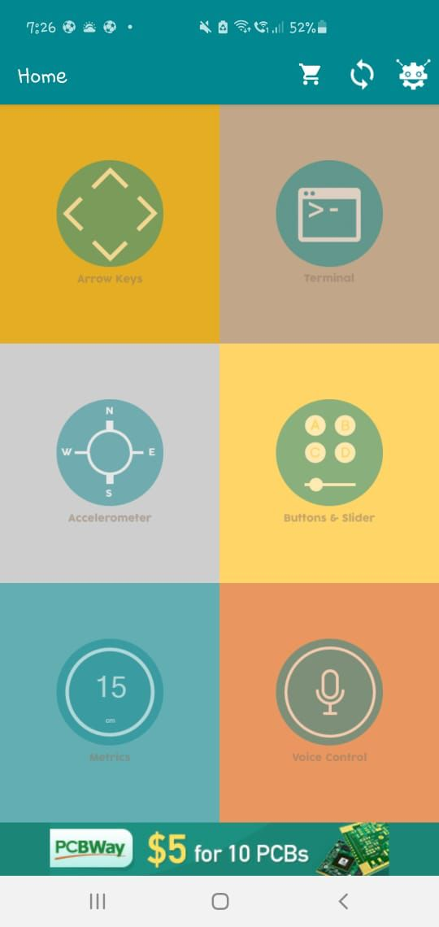

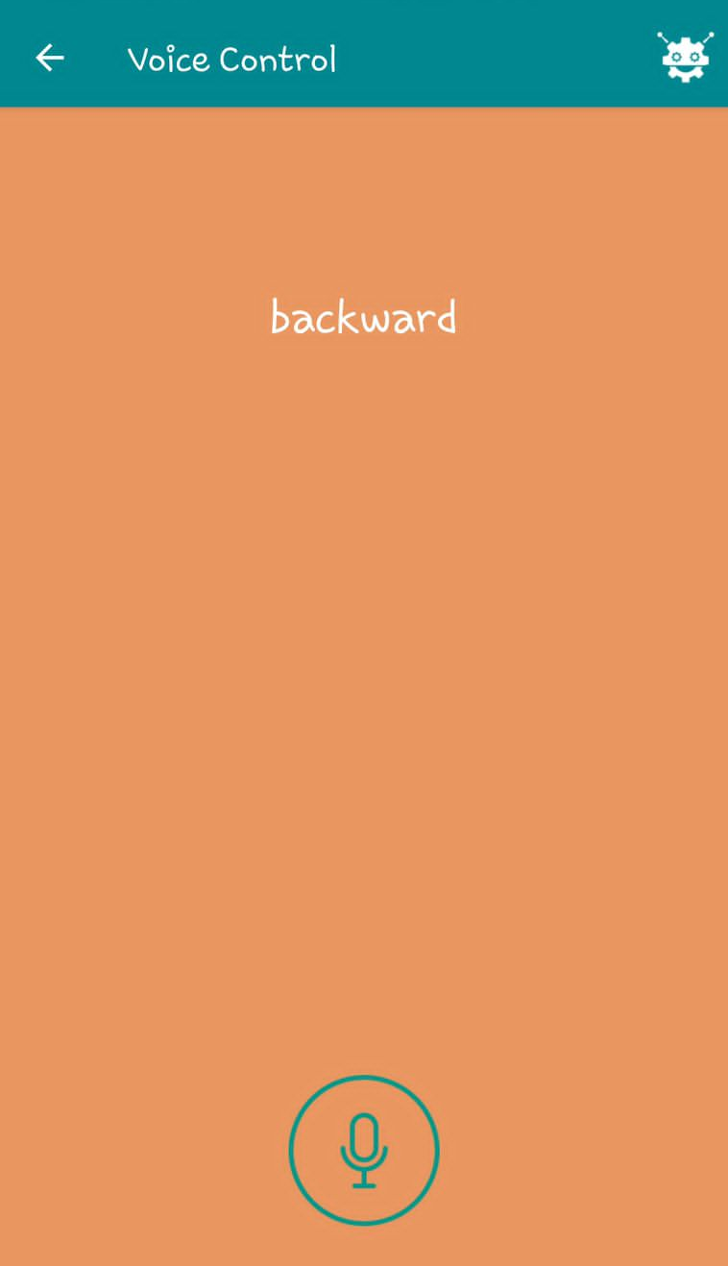
Testing Step

Slide 21
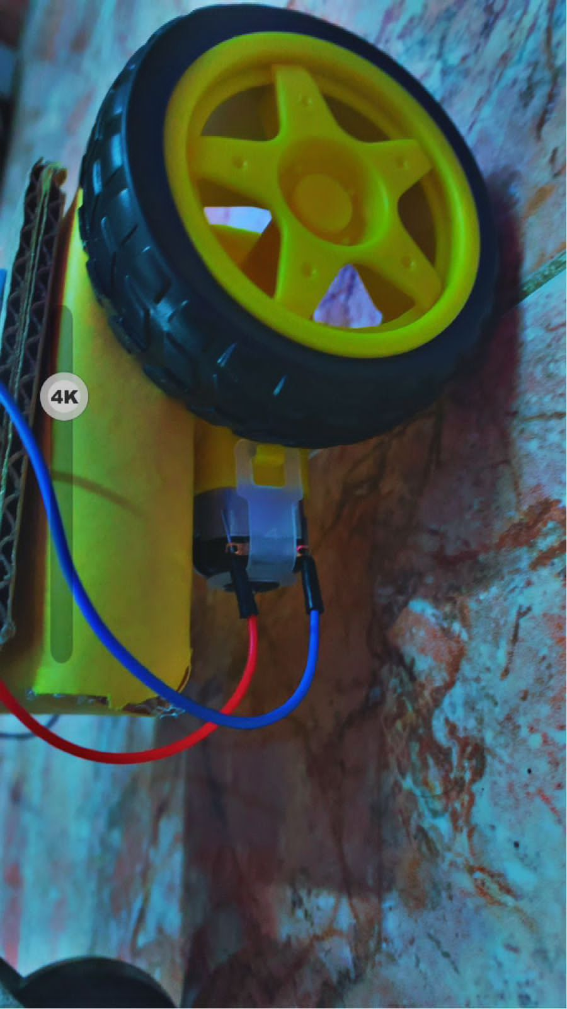
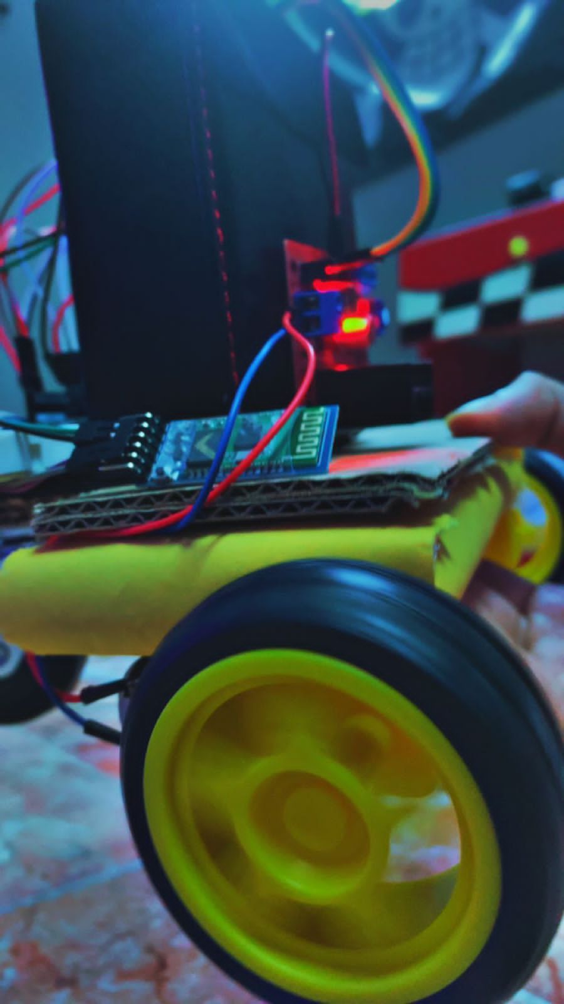
The Output

Slide 22
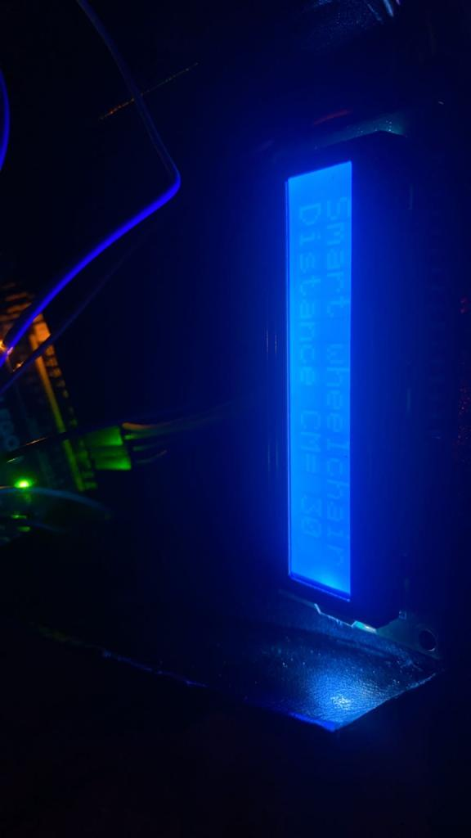
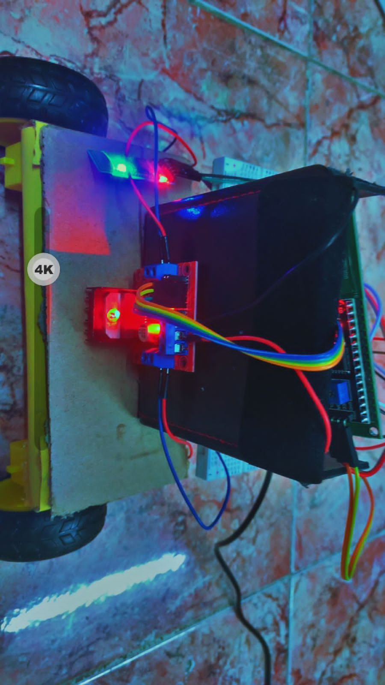
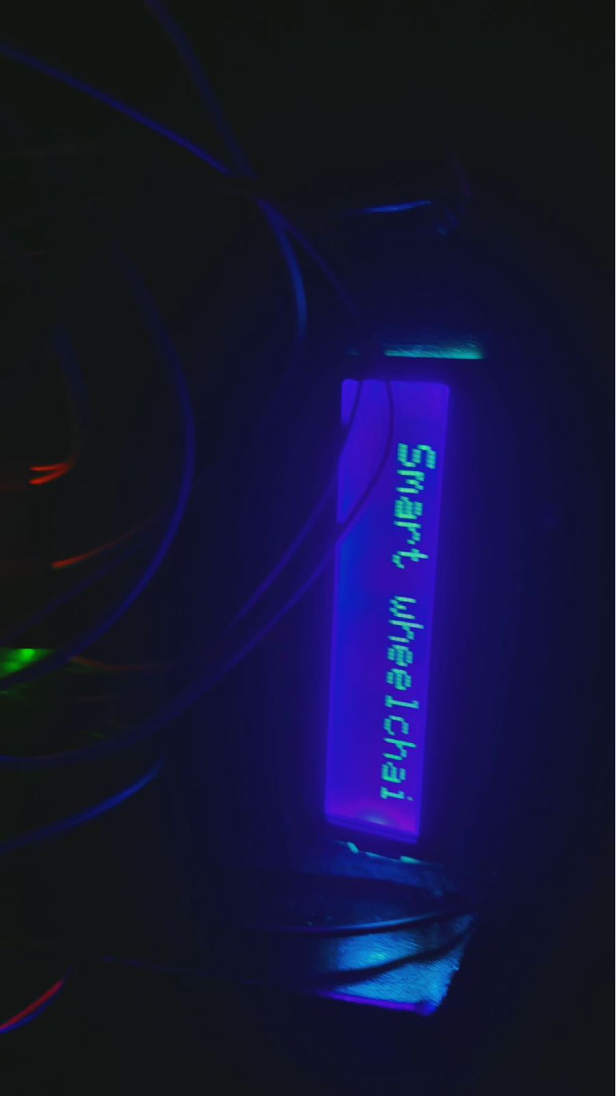
The Output

Slide 23
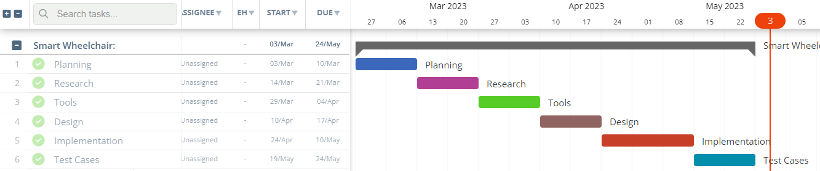
Gantt Chart

Slide 24
Acknowledgments
In the last thing, I would like to express my infinite and deepest thanks and gratitude to Allah for his great and everlasting care and blessing.
Thanks, and appreciator for our supervisor Dr. Rizwan Shaik for interested and all what he did with us.
And we wish the best for all….

Slide 25

Thanks For Listening

